Slide 1


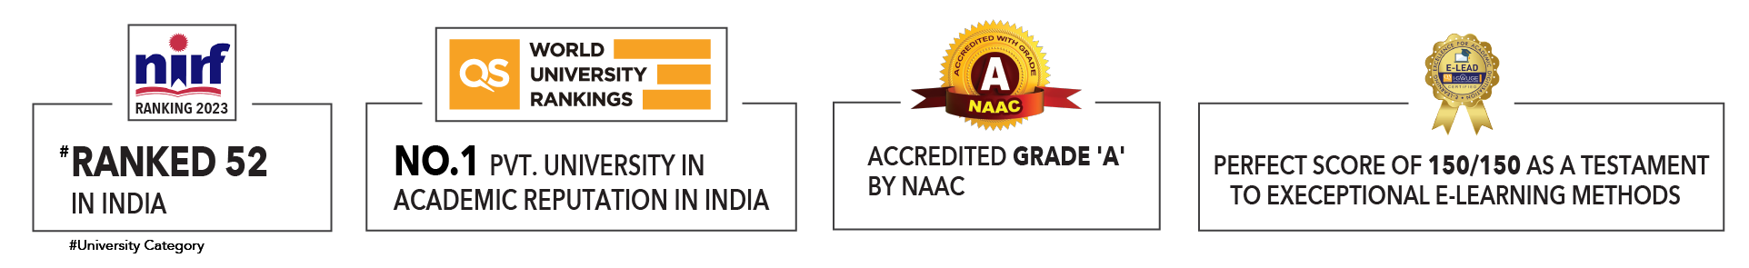

Slide 2

Unit 4 : Types of machine learning
Lecture 2: Regression and its types
School of Computer Science UPES, Dehradun
India

Slide 3
Table of Contents
Regression and its types
Regression Analysis
Types of Regressions
Linear Regression
Multiple Regression
Bias vs Variance
Performance of Regression models
R Square
MSE & RMSE
MAE

Slide 4
Learning & Course Outcomes
LO1: To define regression analysis and its types. Identify assumptions and limitations.
LO2: To interpret regression concepts.
LO3: To apply regression to analyze datasets.
LO4: To assess and evaluate appropriateness of regression models.
CO2: Understand the basics of Machine Learning and its types.

Slide 5
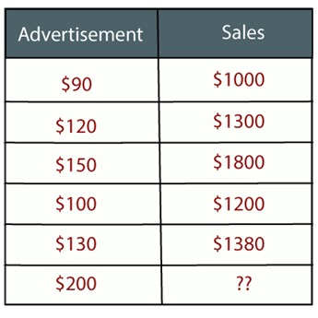
Regression Analysis
Example: Suppose there is a marketing company A, who does various advertisement every year and get sales on that. The below list shows the advertisement made by the company in the last 5 years and the corresponding sales:
Now, the company wants to do the advertisement of $200 in the year 2023 and wants to know the prediction about the sales for this year.
So, to solve such type of prediction problems in machine learning, we need regression analysis.

Slide 6
Supervised vs. Unsupervised Learning
Supervised learning (regression and classification)
Supervision: The training data (observations, measurements, etc.) are accompanied by labels indicating the class of the observations
New data is classified based on the training set
Unsupervised learning (clustering)
The class labels of training data is unknown
Given a set of measurements, observations, etc. with the aim of establishing the existence of classes or clusters in the data

Slide 7
Regression Analysis
Regression is a supervised learning technique which helps in finding the correlation between variables and enables us to predict the continuous output variable based on the one or more predictor variables.
It is mainly used for prediction, forecasting, time series modeling, and determining the causal-effect relationship between variables.
In Regression, we plot a graph between the variables which best fits the given datapoints, using this plot, the machine learning model can make predictions about the data.

Slide 8
Regression Analysis
"Regression shows a line or curve that passes through all the datapoints on target-predictor graph in such a way that the vertical distance between the datapoints and the regression line is minimum."
The distance between datapoints and line tells whether a model has captured a strong relationship or not.
Some examples of regression can be as:
Prediction of rain using temperature and other factors
Determining Market trends
Prediction of road accidents due to rash driving.

Slide 9
Why do we use Regression Analysis ?
Regression analysis helps in the prediction of a continuous variable.
There are various scenarios in the real world where we need some future predictions such as weather condition, sales prediction, marketing trends, etc., for such case we need some technology which can make predictions more accurately.
So for such case we need Regression analysis which is a statistical method and used in machine learning and data science.
Below are some other reasons for using Regression analysis:
Regression estimates the relationship between the target and the independent variable.
It is used to find the trends in data.
It helps to predict real/continuous values.
By performing the regression, we can confidently determine the most important factor, the least important factor, and how each factor is affecting the other factors.

Slide 10
Terminology related to Regression Analysis
Dependent Variable: The main factor in Regression analysis which we want to predict is called the dependent variable. It is also called target variable.
Independent Variable: The factors which affect the dependent variables or which are used to predict the values of the dependent variables are called independent variable, also called as a predictor.
Outliers: Outlier is an observation which contains either very low value or very high value in comparison to other observed values. An outlier may hamper the result, so it should be avoided.
Multicollinearity: If the independent variables are highly correlated with each other than other variables, then such condition is called Multicollinearity. It should not be present in the dataset, because it creates problem while ranking the most affecting variable.
Underfitting and Overfitting: If our algorithm works well with the training dataset but not well with test dataset, then such problem is called Overfitting. And if our algorithm does not perform well even with training dataset, then such problem is called underfitting.

Slide 11
Types of Regression
Linear Regression
Multiple Regression
Logistic Regression (Will be covered in classification)

Slide 12
Linear Regression
Linear regression is a statistical regression method which is used for predictive analysis.
It is one of the very simple and easy algorithms which works on regression and shows the relationship between the continuous variables.
It is used for solving the regression problem in machine learning.
Linear regression shows the linear relationship between the independent variable (X-axis) and the dependent variable (Y-axis), hence called linear regression.
If there is only one input variable (x), then such linear regression is called simple linear regression. And if there is more than one input variable, then such linear regression is called multiple linear regression.
The relationship between variables in the linear regression model can be explained using the below image. Here we are predicting the salary of an employee on the basis of the year of experience.

Slide 13
Linear Regression
Simple Linear Regression is a type of Regression algorithms that models the relationship between a dependent variable and a single independent variable. The relationship shown by a Simple Linear Regression model is linear or a sloped straight line, hence it is called Simple Linear Regression.
The key point in Simple Linear Regression is that the dependent variable must be a continuous/real value. However, the independent variable can be measured on continuous or categorical values.
Simple Linear regression algorithm has mainly two objectives:
Model the relationship between the two variables. Such as the relationship between Income and expenditure, experience and Salary, etc.
Forecasting new observations. Such as Weather forecasting according to temperature, Revenue of a company according to the investments in a year, etc.

Slide 14
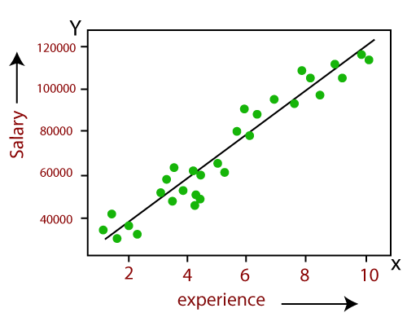
Linear Regression
Mathematical equation for Linear regression: Y= a1 + a2X
Here,
Y = dependent variables (target variables), X= Independent variables (predictor variables), a1 and a2 are the linear coefficients

Slide 15
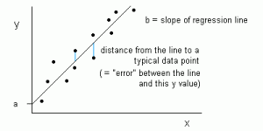
Linear Regression
Linear Regression model can be represented using the below equation:
Y= a1 + a2 X + ε
Here,
a1 = It is the intercept of the Regression line (can be obtained putting x=0)
a2 = It is the slope of the regression line, which tells whether the line is increasing or decreasing.
ε = The error term. (For a good model it will be negligible)

Slide 16

Cost Function
The cost function helps to figure out the best possible values for a0 and a1, which provides the best fit line for the data points.
Cost function optimizes the regression coefficients or weights and measures how a linear regression model is performing. The cost function is used to find the accuracy of the mapping function that maps the input variable to the output variable. This mapping function is also known as the Hypothesis function.
In Linear Regression, Mean Squared Error (MSE) cost function is used, which is the average of squared error that occurred between the predicted values and actual values.
Let’s: yi = actual values and mxi+b = predicted value

Slide 17
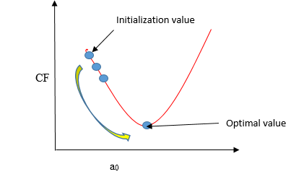
Gradient Descent
Gradient descent is a method of updating a0 and a1 to minimize the cost function (MSE).
A regression model uses gradient descent to update the coefficients of the line (a0, a1 => xi, b) by reducing the cost function by a random selection of coefficient values and then iteratively update the values to reach the minimum cost function.

Slide 18
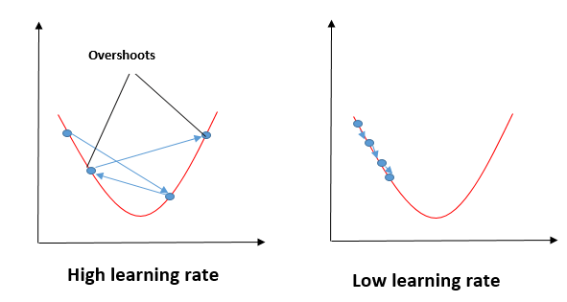
Gradient Descent

Slide 19
Gradient Descent
Imagine a pit in the shape of U. You are standing at the topmost point in the pit, and your objective is to reach the bottom of the pit. There is a treasure, and you can only take a discrete number of steps to reach the bottom.
If you decide to take one footstep at a time, you will eventually get to the bottom of the pit but, this will take a longer time.
If you choose to take longer steps each time, you may get to sooner but, there is a chance that you could overshoot the bottom of the pit and not near the bottom.
In the gradient descent algorithm, the number of steps you take is the learning rate, and this decides how fast the algorithm converges to the minima.

Slide 20
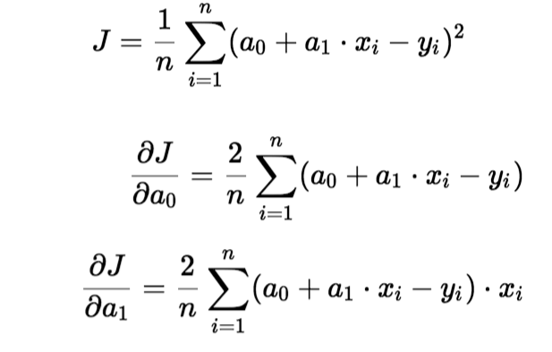
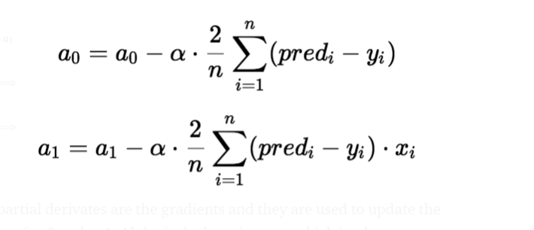
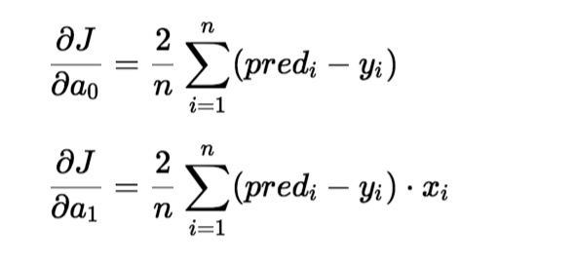
Gradient Descent
To update a₀ and a₁, we take gradients from the cost function. To find these gradients, we take partial derivatives for a₀ and a₁
The partial derivates are the gradients, and they are used to update the values of a₀ and a₁.
Alpha is the learning rate.

Slide 21
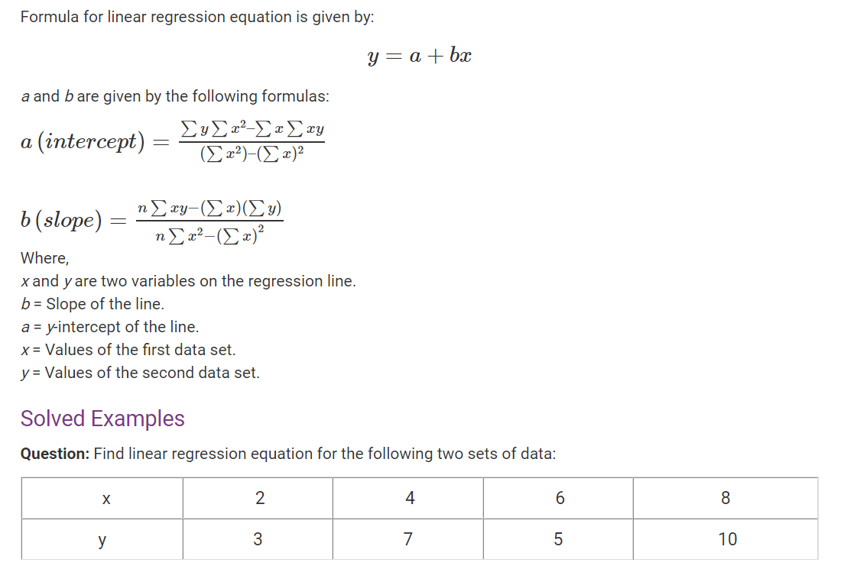
Numerical of Linear Regression

Slide 22
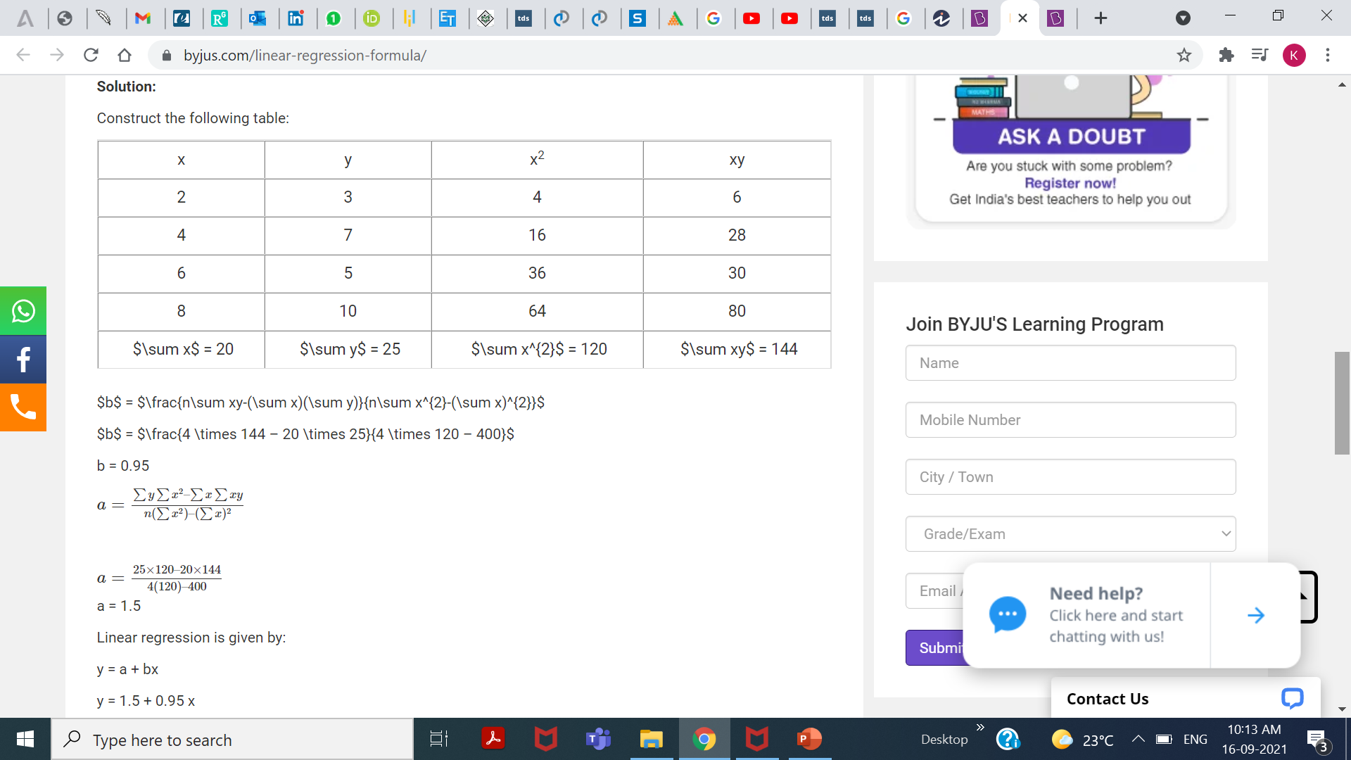
Numerical Solution

Slide 23
Multiple Linear Regression
Multiple linear regression is used to estimate the relationship between two or more independent variables and one dependent variable. You can use multiple linear regression when you want to know:
How strong the relationship is between two or more independent variables and one dependent variable (e.g. how rainfall, temperature, and amount of fertilizer added affect crop growth).
The value of the dependent variable at a certain value of the independent variables (e.g. the expected yield of a crop at certain levels of rainfall, temperature, and fertilizer addition).

Slide 24
Assumptions of Multiple Linear Regression
Multiple linear regression makes all of the same assumptions as simple linear regression:
Homogeneity of variance (homoscedasticity): the size of the error in our prediction doesn’t change significantly across the values of the independent variable.
Independence of observations: the observations in the dataset were collected using statistically valid methods, and there are no hidden relationships among variables.
In multiple linear regression, it is possible that some of the independent variables are actually correlated with one another, so it is important to check these before developing the regression model. If two independent variables are too highly correlated (r2 > ~0.6), then only one of them should be used in the regression model.
Normality: The data follows a normal distribution.
Linearity: the line of best fit through the data points is a straight line, rather than a curve or some sort of grouping factor.

Slide 25

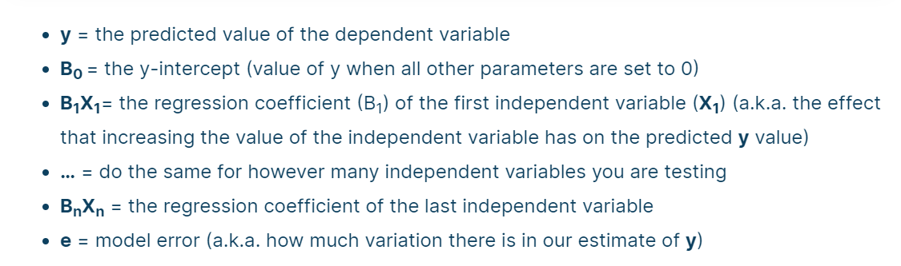
Multiple Linear Regression Formula
Multiple linear regression formula

Slide 26
How to perform Multiple Linear Regression?
To find the best-fit line for each independent variable, multiple linear regression calculates three things:
The regression coefficients that lead to the smallest overall model error.
The t-statistic of the overall model.
The associated p-value (how likely it is that the t-statistic would have occurred by chance if the null hypothesis of no relationship between the independent and dependent variables was true).
It then calculates the t-statistic and p-value for each regression coefficient in the model.

Slide 27
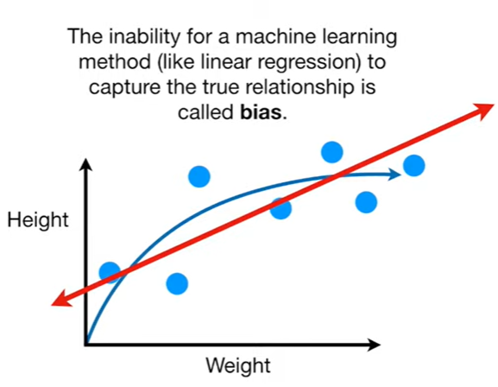
Bias
Biases are the underlying assumptions that are made by data to simplify the target function.
Bias does help us generalize the data better and make the model less sensitive to single data points.
It also decreases the training time because of the decrease in complexity of target function High bias suggest that there is more assumption taken on target function.
This leads to the underfitting of the model sometimes.
Examples of High bias Algorithms include Linear Regression, Logistic Regression etc.

Slide 28
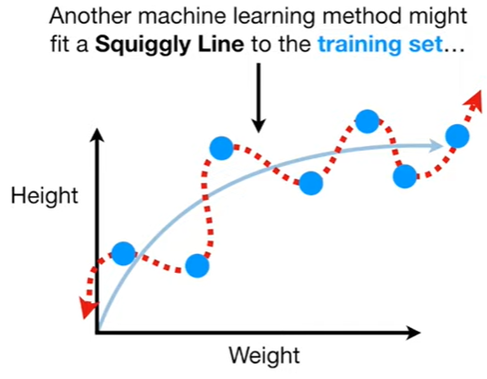
Variance
Variance refers to the degree to which a model is able to adapt to new data.
Variance is a type of error that occurs due to a model’s sensitivity to small fluctuations in the dataset.
The high variance would cause an algorithm to model the outliers/noise in the training set.
This is most commonly referred to as overfitting.
In this situation, the model basically learns every data point and does not offer good prediction when it tested on a novel dataset. Examples of High variance Algorithms include Decision Tree, KNN etc.

Slide 29
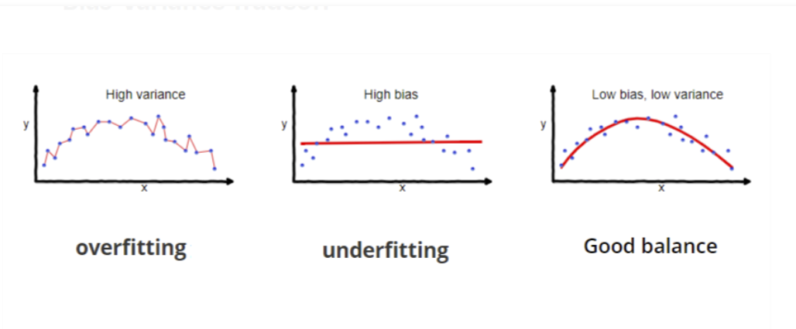
Variance

Slide 30
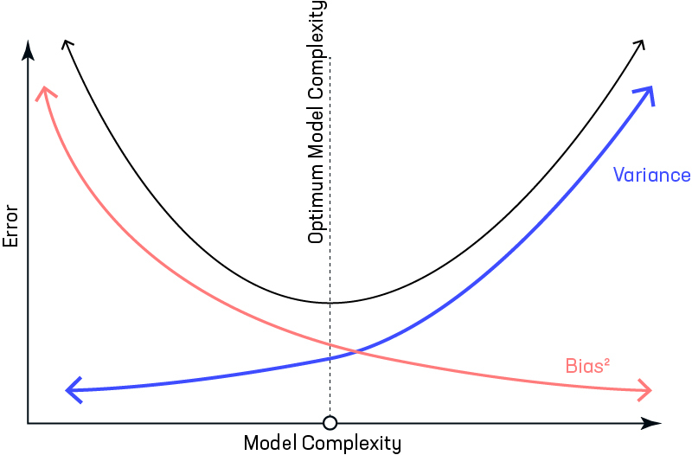
Bias vs Variance tradeoff

Slide 31
Regularization
Let us consider that we have a very accurate model, this model has a low error in predictions and it’s not from the target.
This model has low bias and variance.
Now, if the predictions are scattered here and there then that is the symbol of high variance, also if the predictions are far from the target, then that is the symbol of high bias. Sometimes we need to choose between low variance and low bias.
There is an approach that prefers some bias over high variance, this approach is called Regularization.
It works well for most of the classification/regression problems.

Slide 32
Performance of Regression models
To calculate the performance of regression models, we utilize mathematical formulas that will compare the plotted graph to the points that we are predicting.
A good regression model should focus on minimizing the difference between the observation and the predicted value, while being unbiased. (Unbiased means that we try to find a balance between over-estimation and under-estimation)
There are 3 main metrics for model evaluation in regression:
R Square
Mean Square Error(MSE)/Root Mean Square Error(RMSE)
Mean Absolute Error(MAE)

Slide 33
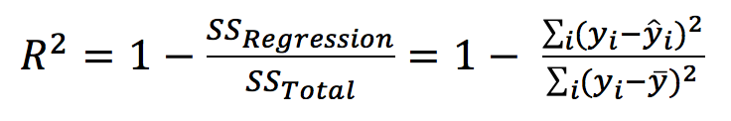
R Square/Adjusted R Square
R Square measures how much variability in dependent variable can be explained by the model. It is the square of the Correlation Coefficient(R) and that is why it is called R Square.
R Square is calculated by the sum of squared of prediction error divided by the total sum of the square which replaces the calculated prediction with mean.
R Square value is between 0 to 1 and a bigger value indicates a better fit between prediction and actual value.

Slide 34
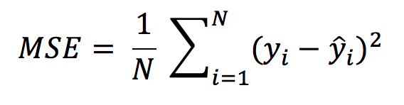
Mean Square Error(MSE) / Root Mean Square Error(RMSE)
While R Square is a relative measure of how well the model fits dependent variables, Mean Square Error is an absolute measure of the goodness for the fit.
MSE is calculated by the sum of square of prediction error which is real output minus predicted output and then divide by the number of data points. It gives you an absolute number on how much your predicted results deviate from the actual number.
Root Mean Square Error(RMSE) is the square root of MSE.

Slide 35
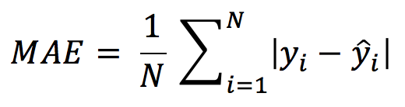
Mean Absolute Error(MAE)
Mean Absolute Error(MAE) is similar to Mean Square Error(MSE). However, instead of the sum of square of error in MSE, MAE is taking the sum of the absolute value of error.
Compared to MSE or RMSE, MAE is a more direct representation of sum of error terms.
MSE gives larger penalization to big prediction error by square it while MAE treats all errors the same.

Slide 36
Summary
Regression is a machine learning technique used for predicting continuous outcomes based on input features.
It models the relationship between a dependent variable and one or more independent variables.
Types of Regression:
Linear Regression:
Predicts the dependent variable as a linear combination of the independent variables.
Simple Linear Regression: One independent variable.
Multiple Linear Regression: Multiple independent variables.
Polynomial Regression:
Extends linear regression by adding polynomial terms to the model.
Captures non-linear relationships between the dependent and independent variables.
Logistic Regression:
Used for binary classification problems.
Models the probability of the target variable being in a particular class.
Applications: Predicting house prices, stock prices, sales forecasting, and other continuous outcomes.

Slide 37
Reference Material
Machine Learning for Dummies, By John Paul Mueller and Luca Massaron, For Dummies, 2016.
NPTEL video: https://www.youtube.com/watch?v=OQV8WmUdeIo

Slide 38
MCQ’s
Which of the following is the primary goal of regression analysis in machine learning?
a) Classification b) Clustering c) Predicting a continuous outcome d) Reducing dimensionality
Which type of regression is best suited for predicting a binary outcome?
a) Linear Regression b) Logistic Regression c) Polynomial Regression d) Ridge Regression
In linear regression, what does the term 'residual' refer to?
a) The slope of the regression line b) The difference between the observed and predicted values c) The y-intercept of the regression line d) The dependent variable

Slide 39
MCQ’s
4. Which of the following algorithms is not a type of regression?
a) Support Vector Regression
b) Decision Tree Regression
c) Random Forest Regression
d) K-Nearest Neighbors Classification
5. What does the 'R-squared' value represent in a regression model?
a) The average error of the model
b) The proportion of variance in the dependent variable that is predictable from the independent variable(s)
c) The p-value of the regression coefficients
d) The residual sum of squares
6.Which type of regression is useful for modeling the relationship between a dependent variable and multiple independent variables?
a) Simple Linear Regression
b) Multiple Linear Regression
c) Polynomial Regression
d) Ridge Regression

Slide 40
MCQ’s Answers
Answers
1. c) Predicting a continuous outcome
2. b) Logistic Regression
3. b) The difference between the observed and predicted values
4. d) K-Nearest Neighbors Classification
5. b) The proportion of variance in the dependent variable that is predictable from the independent variable(s)
6. b) Multiple Linear Regression

Slide 41
What’s Next
Classification

Slide 42

Thank You

